Slide 1

DEVELOPMENT OF IoT BASED SMART PARKING SYSTEM A SOLUTION TO UNBALANCED PARKING DEMANDS
SUBMITTED BY:
Alankruta padhi
MANNMATH SAMANTARAY
MONALI SENAPATI
MONALISHA MAHAPATRA
SUSHREE SUBHALAXMI DAS
NIHALI CHOUDHURY
SUBHAM ABHISEK
UNDER THE GUIDANCE OF :
DR. NIRANJAN PANIGRAHI
ASSISTANT PROFESSOR

Slide 2
OUTLINE
REQUIREMENT OF A SMART PARKING SYSTEM
IMPORTANCE OF THE SOLUTION
TECHNICAL CHALLENGES
METHODOLOGY AND NETWORK ARCHITECTURE
MATHEMATICAL MODEL
SIMULATION OF THE SYSTEM
PERFORMANCE OF THE SYSTEM
IMPLEMENTATION OF THE SYSTEM
WORKING OF THE SYSTEM
CONCLUSION AND FUTUREWORK
REFERENCES

Slide 3
THE PROBLEM
According to International Parking Institute (IPI), 60 percent of the total population will live in cities by 2030, and Green Car Reports (News-feed Reportage Website) estimates that the number of vehicles on the road is about 1.2 billion now and is likely to reach 2 billion by 2035.
There are many wastage instances of natural resources due to the cruising vehicles. Again the carbon footprint on natural biomes is also a considerable factor. Hence, an optimal strategy to find a parking spot can relieve traffic congestion, reduce air pollution and enhance driving comfortability.
Basically in the parking optimization is based on two costs.
Individual Cost
Social Cost

Slide 4
IMPORTANCE OF THE SYSTEM
Smart Parking involves the use of low cost sensors, real-time data and applications that allow users to monitor available and unavailable parking spots. The goal is to automate and decrease time spent manually searching for the optimal parking floor, spot and even lot.
Some top benefits of a parking solution are -
Optimized Parking
Reduced Traffic
Reduced Pollution
Increased Safety
Real-Time Data and Trend Insight

Slide 5
TECHNICAL CHALLENGES
Increase in population of vehicles
Adopting Smart Parking Technology
Enabling the tools and techniques
Controlling of congestion
Countering the issues of over parking and low parking
Fake Parking Requests

Slide 6
METHODOLOGY ADOPTED
Parking Sensors
Central Processing Unit
User Application
The Cloud

Slide 7
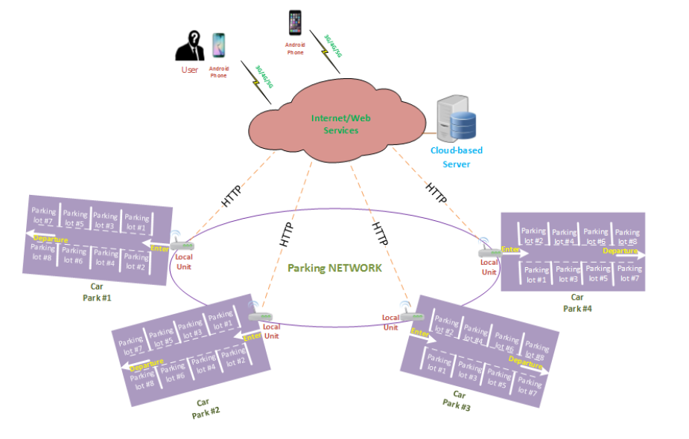
NETWORK ARCHITECTURE
Fig 1. Architecture of the proposed system

Slide 8

MATHEMATICAL MODEL
Where C (a, b): total cost associated with the searching process
a: coefficient depending upon the length between two nodes
b: coefficient depending upon the number of vacant spaces in destination node
d_{ij}: Distance between two neighbouring nodes (Say node P_{i} and P_{j})
D_{up}: Maximum of the distances between current and the neighbouring nodes.
S_{j} :Number of vacant spaces available at P_{j}
S_{up}: Maximum capacity of the whole network

Slide 9
SIMULATION OF THE SYSTEM
Table 1. Parameters for simulation
Fig2.

Slide 10
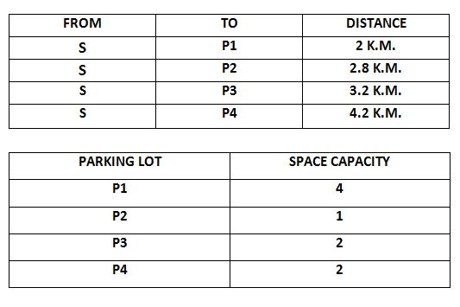
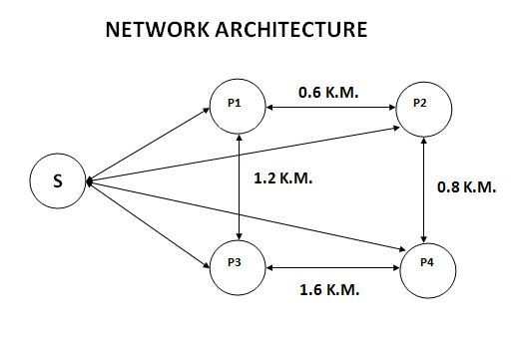
Fig 3. Adopted Network
Table 2. Network Parameters

Slide 11
PERFORMANCE OF THE SYSTEM
Fig 4. Vehicle Distribution

Slide 12
IMPLEMENTATION OF THE SYSTEM
SYSTEM SETUP:
Our system depends upon a set of hardware and software to function.
Hardware setup
Node-MCU(ESP8266)
Arduino NANO
IR proximity sensor
Software setup
FIREBASE
PARK-IT(Web app)

Slide 13
WORKING OF THE SYSTEM
IR sensors are deployed in each parking lot to detect whether a space is free or occupied.
This data is uploaded to a cloud based database(FIREBASE) with the help of ESP8266.
A web app(PARK-IT) is used to fetch the real time data from FIREBASE and then the recommended parking lot is decided using the system algorithm.

Slide 14
CONCLUSION
From the simulation it was concluded that the system shows its best optimality when the values of a and b are 0.2 and 0.8 respectively.
A perfectly balanced distribution of vehicles was realized among the parking lots. This distribution considers both the number of spaces occupied along with the travelling distance between the lots.
And if a lot is completely occupied then the next vehicle is transferred to its neighbour nodes to find out a free space if available.
We successfully implemented a model of the system using IOT and DBAAS services and it efficiently distributes the vehicular density.

Slide 15
FUTUREWORK
RFID implementation
Image processing
Wireless connections
Range of IR sensors

Slide 16
REFERENCES
Parikng assignment problem: An algorithm for balancing parking demand on multiple parking lots – Oanh Tran Thi Kim, VanDung Nguyen
IoT based smart parking system – AbhirupKhana, Rishi Anand
A new “Smart Parking” System Infrastructure and Implementation - YanfengGeng, Christos G. Cassandras
A Reservation-based Smart Parking System - Hongwei Wang

Slide 17
Thank you…

